Slide 1
RxVMS
A practical reactive architecture for Flutter
Thomas Burkhart
Flutter Berlin meetup
10.10. 2018

Slide 2
Why another architecture?
Most existing architectures like MVP/MVVM don‘t match the reactive View updating of Flutter.
redux is one of the most recommend patterns but:
About 30% more boiler plate code than using RxVMS
Hard to read and to explore new redux code base (F12 doesn’t help)
Hard to understand for beginners, starting with the namings (why are reducer called reducers when they don’t reduce anything?).
Extremely rigid making it difficult if you have to step outside the pattern
Doesn’t fit well the Stream interface of Firebase
InheritedModel, InheritedWidget, ScopedModel
To closely coupled to UI code
No clear assignment of responsibilities
Hard to explore
BLOC
No guidance on what is the scope of one BLOCK
StreamSinks used as Eventhandlers instead of a command
Notes:
Redux was great to improve React applictions but not needed with Flutter

Slide 3
Goals of RxVMS
Easy to explore and to understand ( given that you have understood the concept of Streams )
No configuration by convention (violates 1)
Avoiding black magic of a framework (violates 1)
Encourage the feeling of work ownership when working on a team
Clear separation of concerns
Easy to test
Able to scale
Minimal boring boilerplate code
Not too rigid to be flexible
Fun to work with
Highly Reactive
Notes:
5 let the Widgets rule not some central state machine

Slide 4
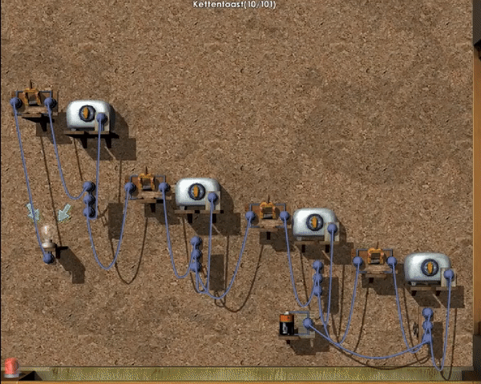

Slide 5
Structure of a RxVMS App
ViewS
Domain Objects
AggregatorsAdapters
ManagerS
ServiceS

Slide 6
Services
Encapsulate functionality beyond the Apps bounderies like:
REST APIs
Databases
OS Services like Contacts / Calendar
Hardware features like Location, acceleration sensors
Convert data from / to the external data format (e.g. JSON) to domain objects
Don’t change any App State on their own
Each Service should only wrap one external aspect.

Slide 7
Managers
Wrap semantically related business logic e.g.
User Management/Authentication
Notification Management
Invoices
No direct mapping to a specific View (Managers ≠ ViewModel)
Often provide CRUD functionality for domain objects
Implement any (business) logic that change App State
Therefore use Services / other Managers
Provide Commands/ Data Streams for the UI
Are accessed by ServiceLocator or DI.

Slide 8
Views
Full Page or Custom View
Are self responsible
Select which data they need from Managers or directly from Services typically by listening on Streams
Modify data by using Commands in Managers
Don’t modify data / state by using Services
Don’t change any state that isn’t related to task the View is made for, that is the duty of business logic inside Managers

Slide 9
Domain Objects
Objects that represent real world objects or abstract concepts from the application domain such as: users, invoices, tickets
If they have methods, they ONLY change their own internal state, never any other objects
Often provide factory functions like to/from JSON that Services can use.
Aggregators
Wrap multiple Domain Objects so that they can be passed over a Stream as one entity. This can be Lists, Tuples or custom Objects
Adapters
If data conversion from the type of a Domain Object is too complex to be used by a View, the Domain Object can be wrapped inside a Adapter that encapsulates the conversion
Rarely needed in Flutter 😉

Slide 10
Interactions inside an RxVMS App
Event Detail View
Event Manager
Database Service
Login View
**
Authentication Service
User Manager
Map View
Location Service
Observables/
Streams
(async) function calls
or Streams
** Can be (async) function calls or Streams or RxCommands. But should be limited as much as possible to avoid unnecessary coupling.
RxComands

Slide 11
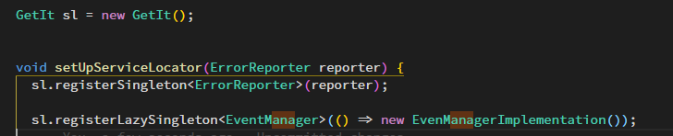
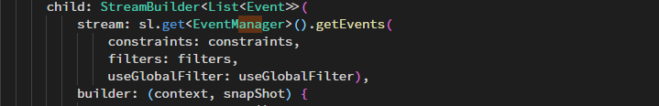
Building blocks: ServiceLocator GetIt
Allows the access to registered objects from anywhere in the App
Objects can be registered with their super type so that the concrete implementation can be exchanged any time.
usage:

Slide 12
Building blocks: RxCommand
Wraps a sync/async function that is executed by calling .execute(value)
Is an Observable<TResult> itself
Is a callable class, so you can assign it directly: onTextChanged: myManager.onSearchChangedCommand,
RxCommand<TParam,TResult>
.execute(TParam)
TResult
canExecuteInput true / false
results CommandResult<TResult>
canExecute true / false
isExecuting true / false
thrownExceptions: Exception
Observable<type>

Slide 13
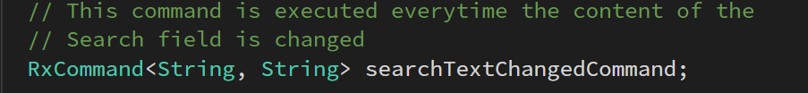
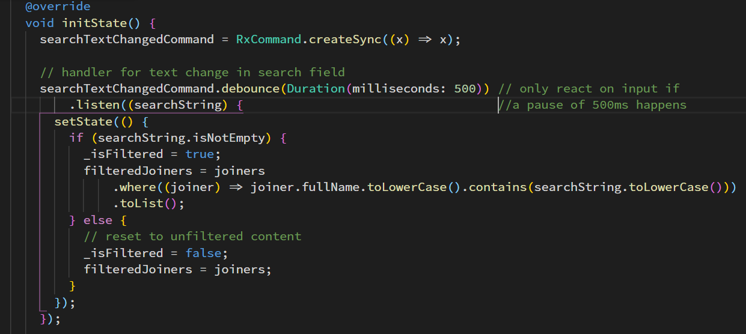
RxCommand usage

Slide 14
The self responsible Widget
Each widget either gets its needed data passed in the constructor or ‘organizes’ it on their own behalf
decides to which data updates it subscribes or which data it wants to pull
only uses Managers/ Services if data outside its own state has to be used / modified
may read data directly from Services
may read/update data via Managers
don’t implement business logic beyond their semantic context
therefore its logic is easy to understand, to test or debug
Encourages feeling of ownership because you implement all the needed functionality for a Widget/Page
Notes:
3. Example a Page that edits user profiles should not call a function in the InvoiceManage if there is a business necessity to interact then the UserManager should deal with that

Slide 15
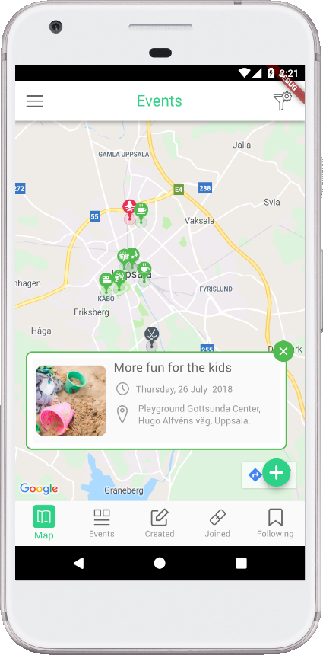
A real-world project using RxVMS: JoinOrCreate http://joinorcreate.com/

Slide 16
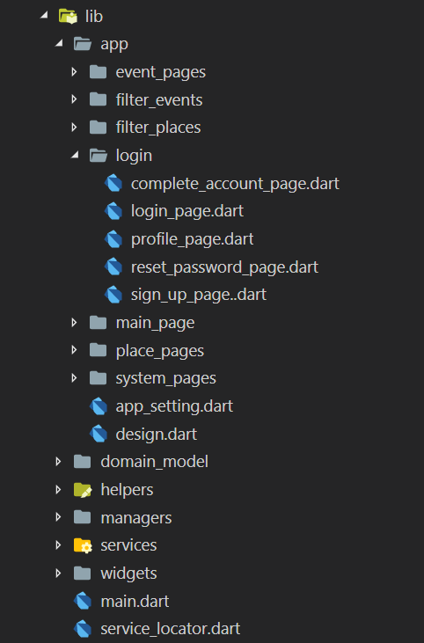
Project structure
app contains all pages and page specific Widgets
pages are grouped by there sematic context
widgets contain all Widgets that are used on more than one page
service_locator.dart contains the global instance of the ServiceLocator (sl) and all object registrations.

Slide 17
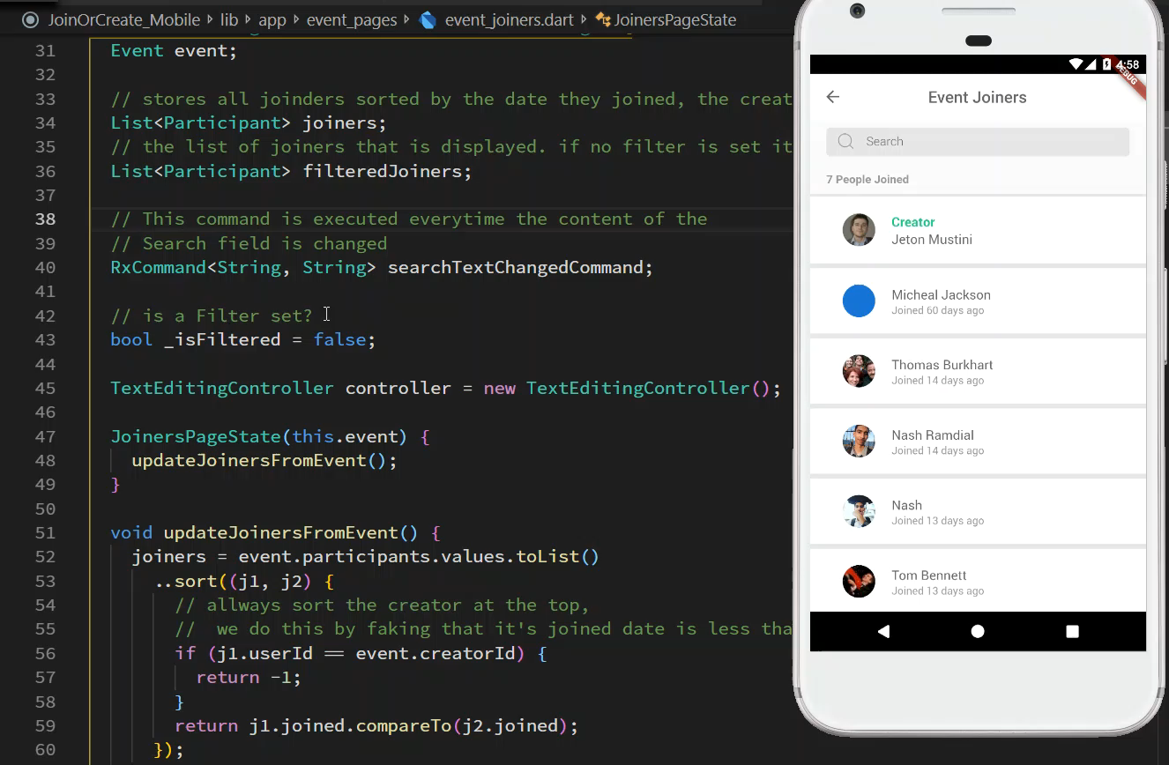
ListView with search field

Slide 18
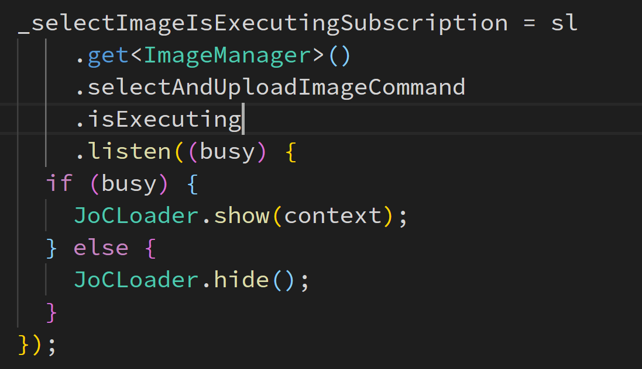
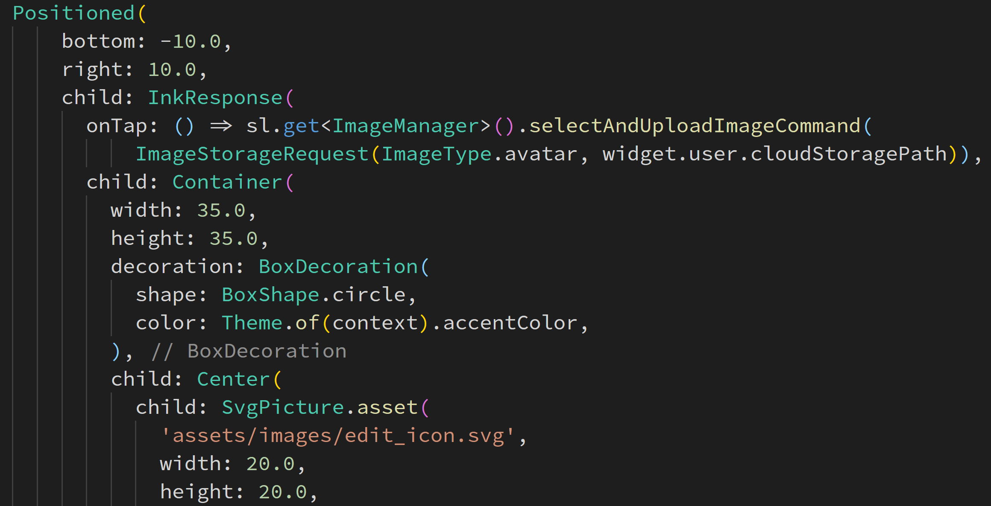
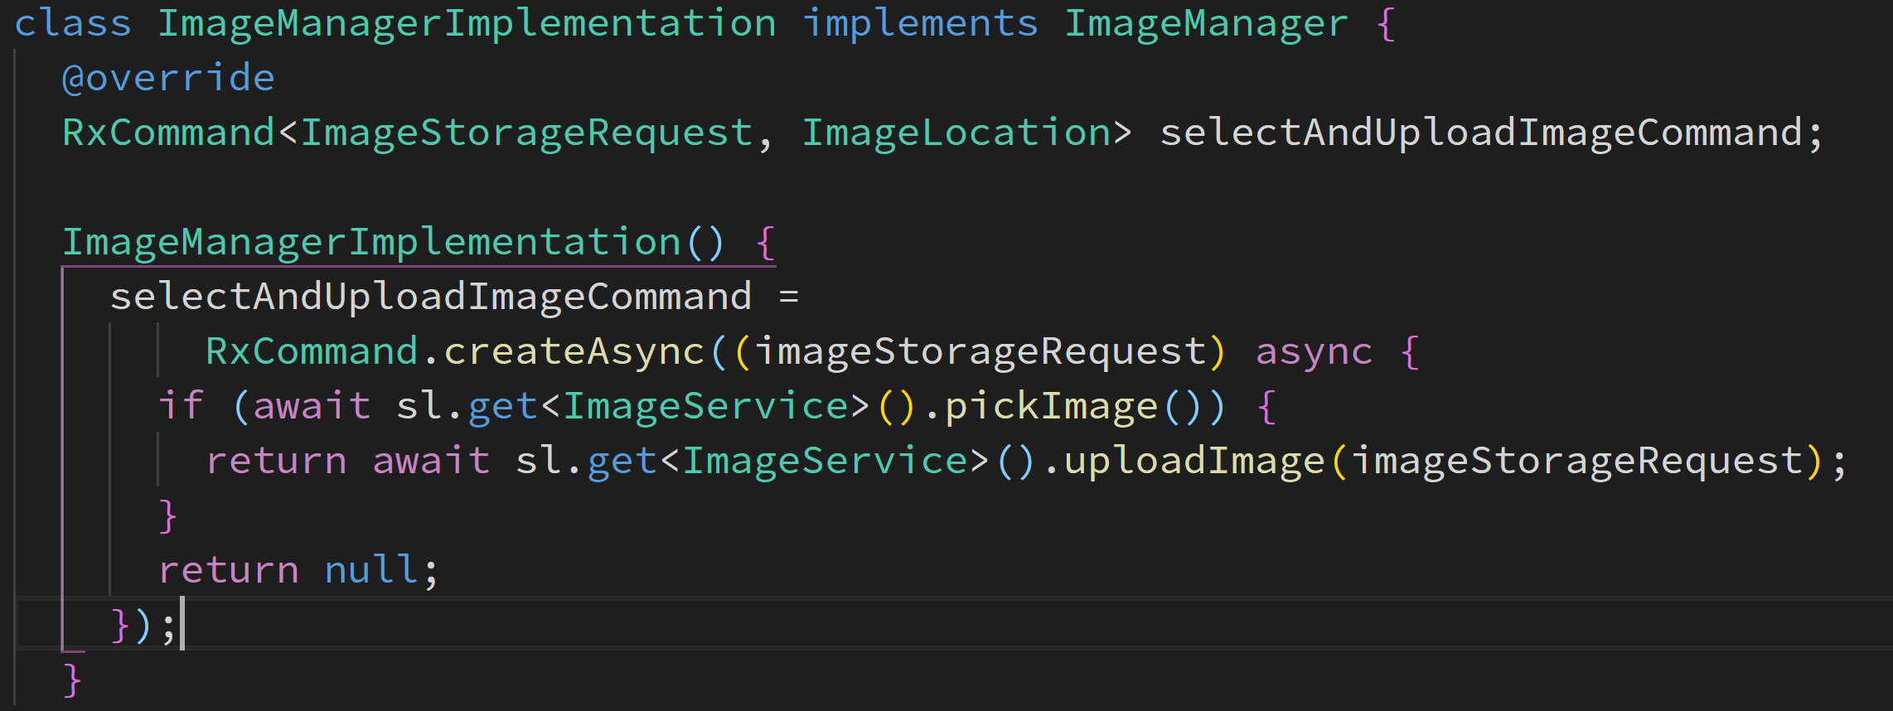
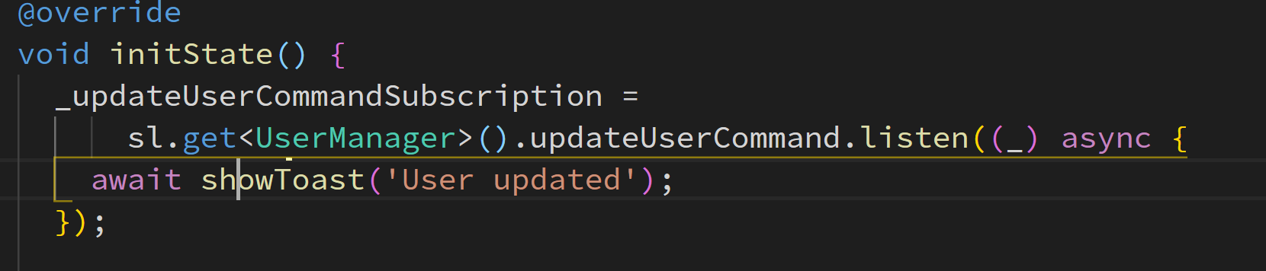
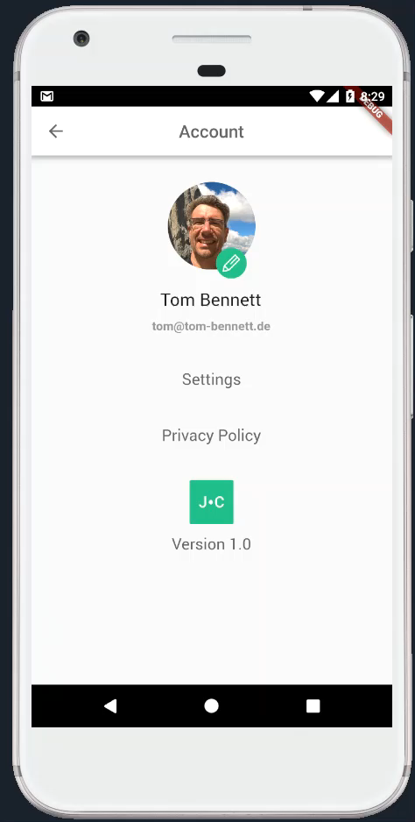
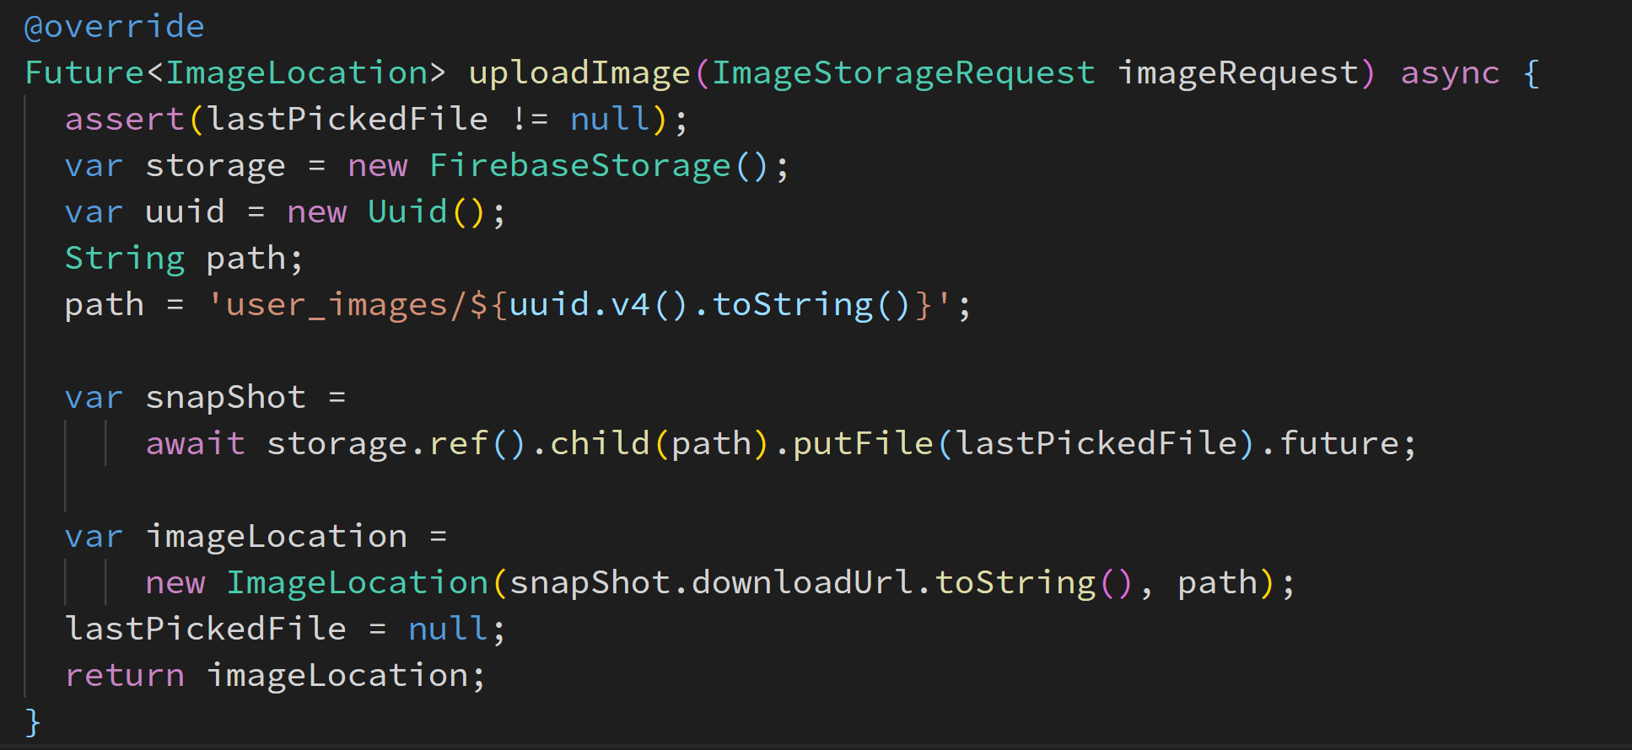
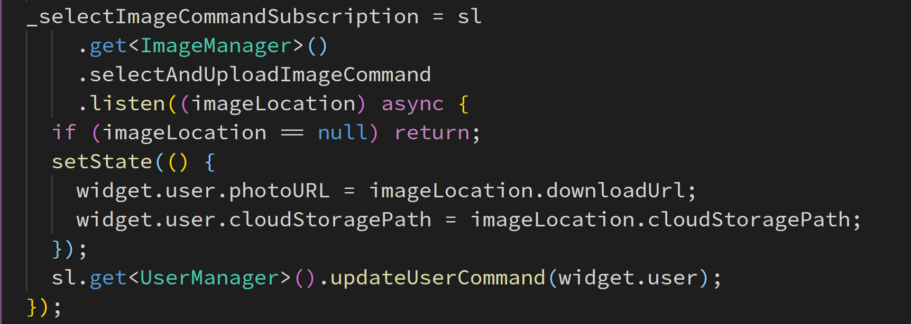
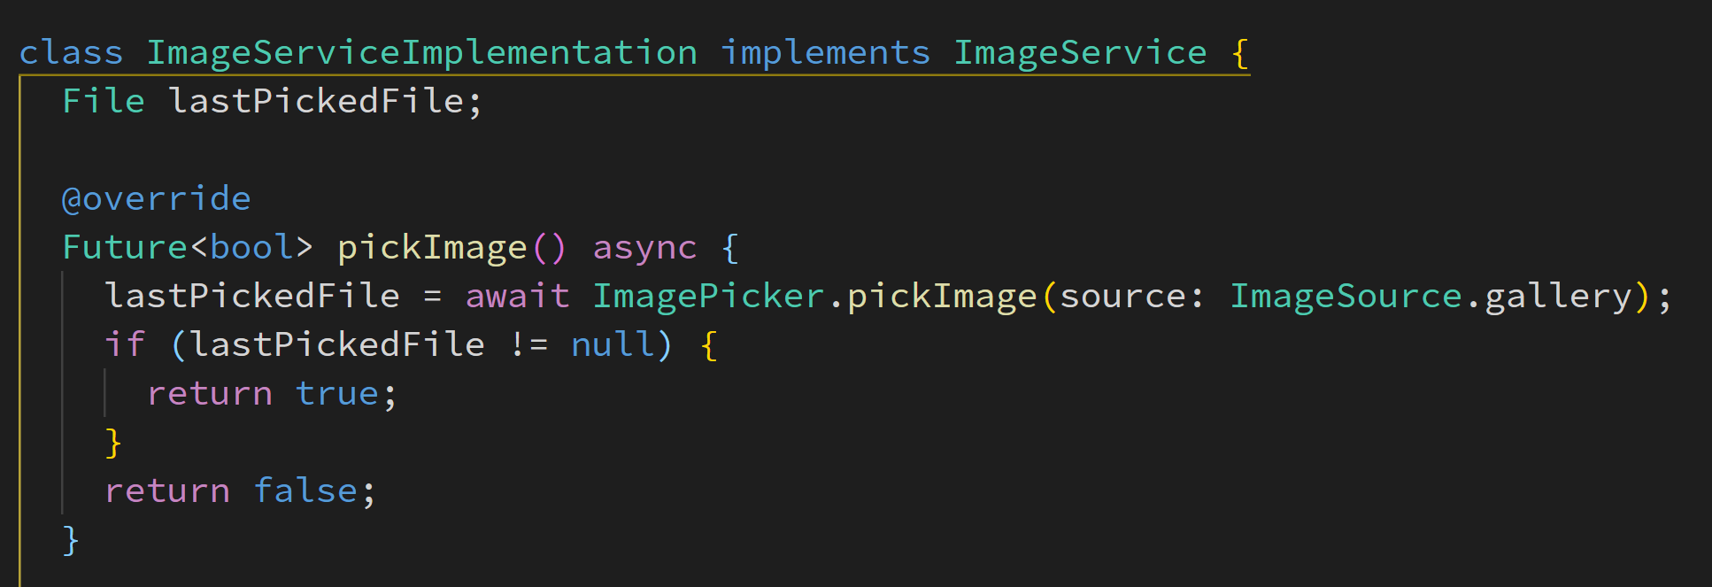
Uploading Image
View
Manager
Service
TResult
isExecuting
canExecute

Slide 19
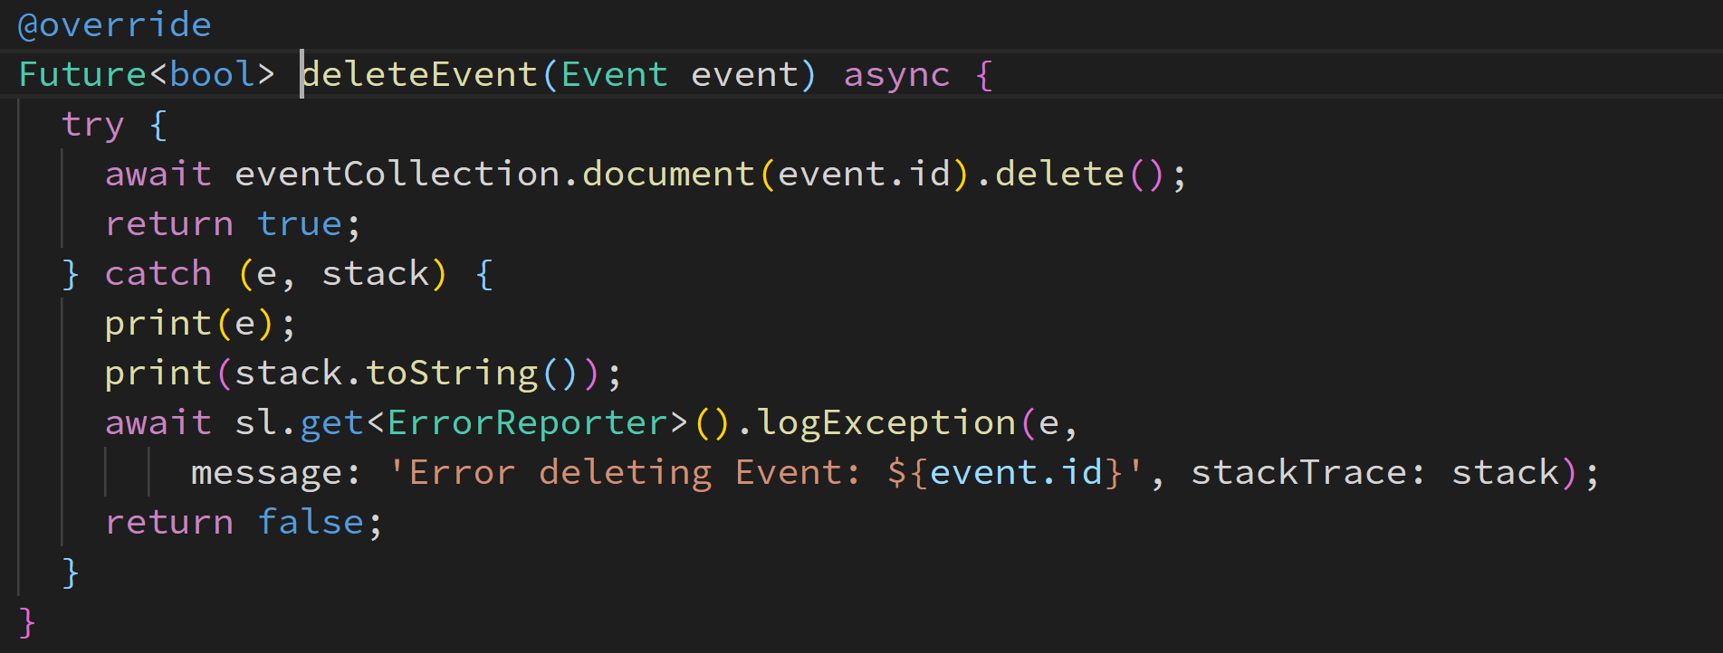
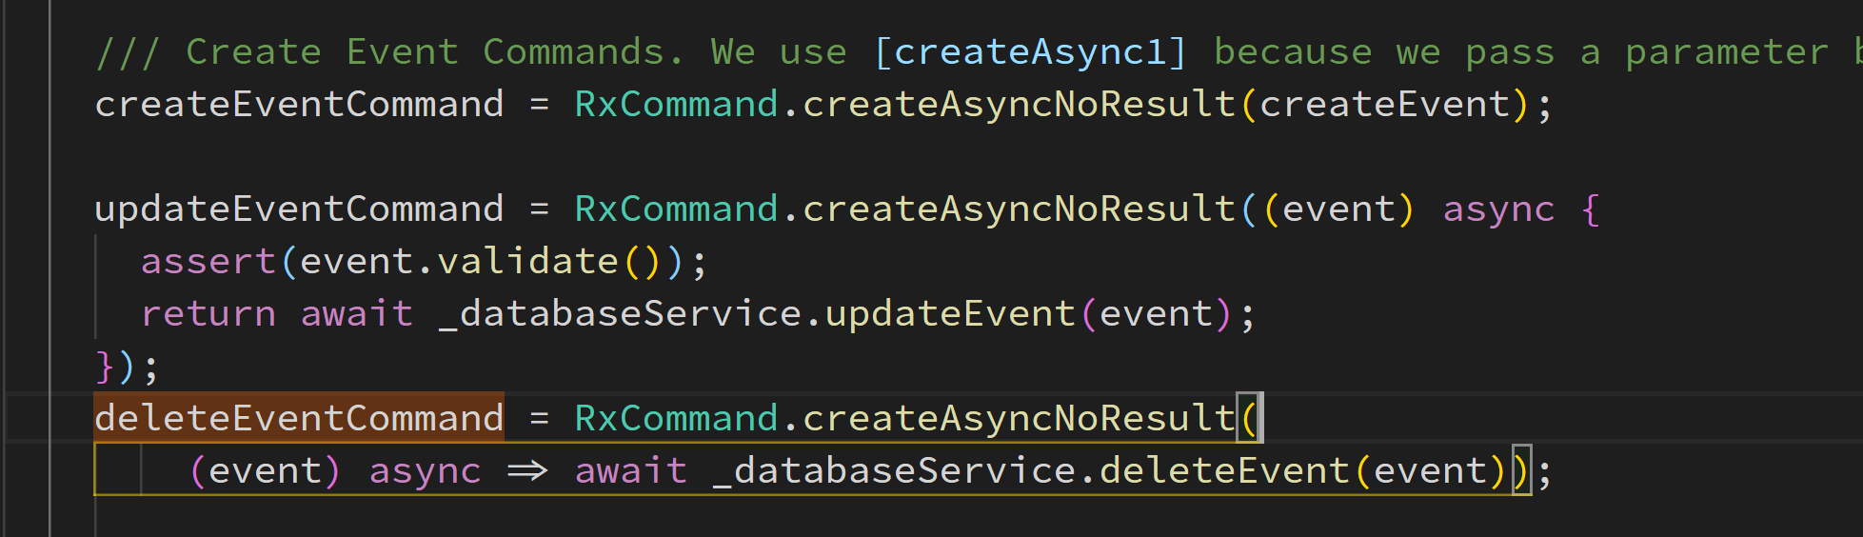
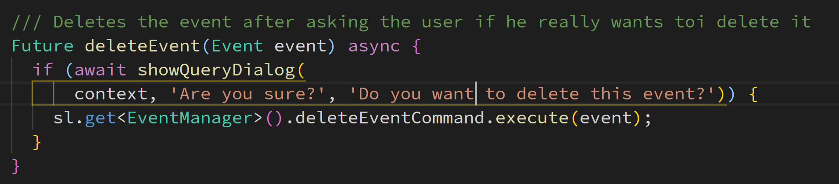
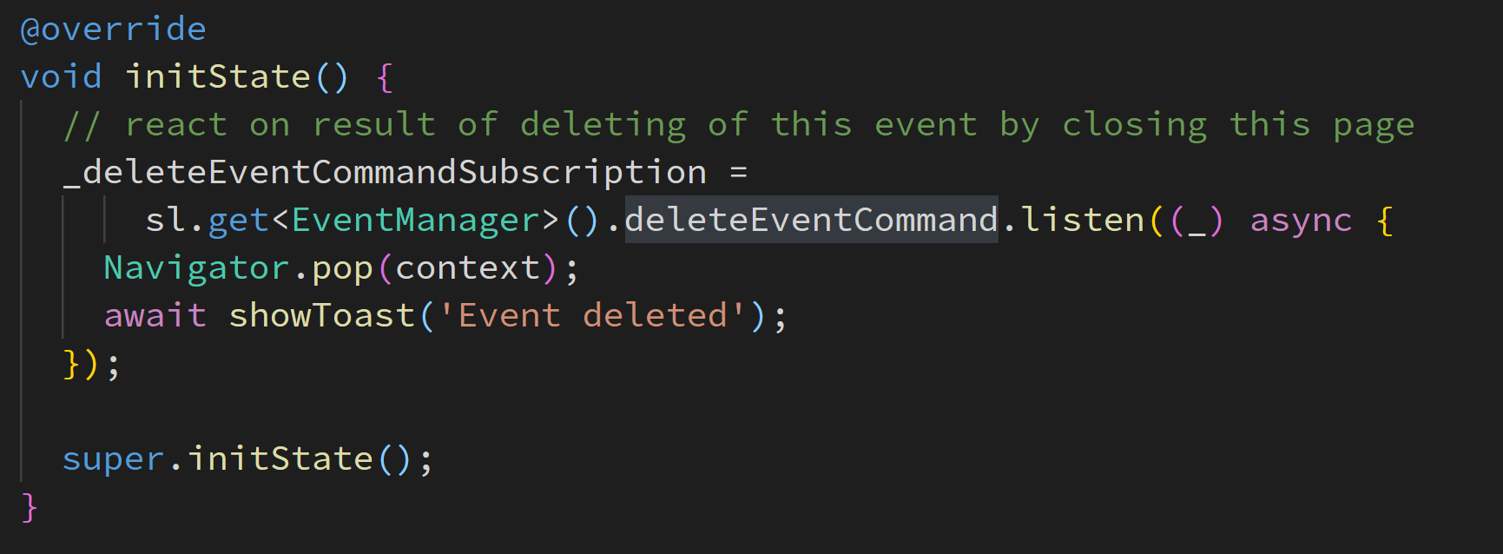
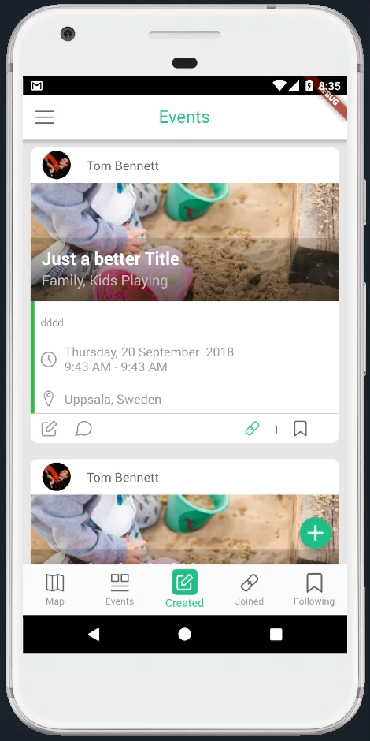
Deleting Events
View
Manager
Service
TResult
isExecuting
canExecute

Slide 20
Resources
My blog: https://www.burkharts.net/apps/blog/
You can find me on Twitter @ThomasBurkhartsB
And on most chats under ‚escamoteur‘

Slide 21
Questions?

